Slide 1
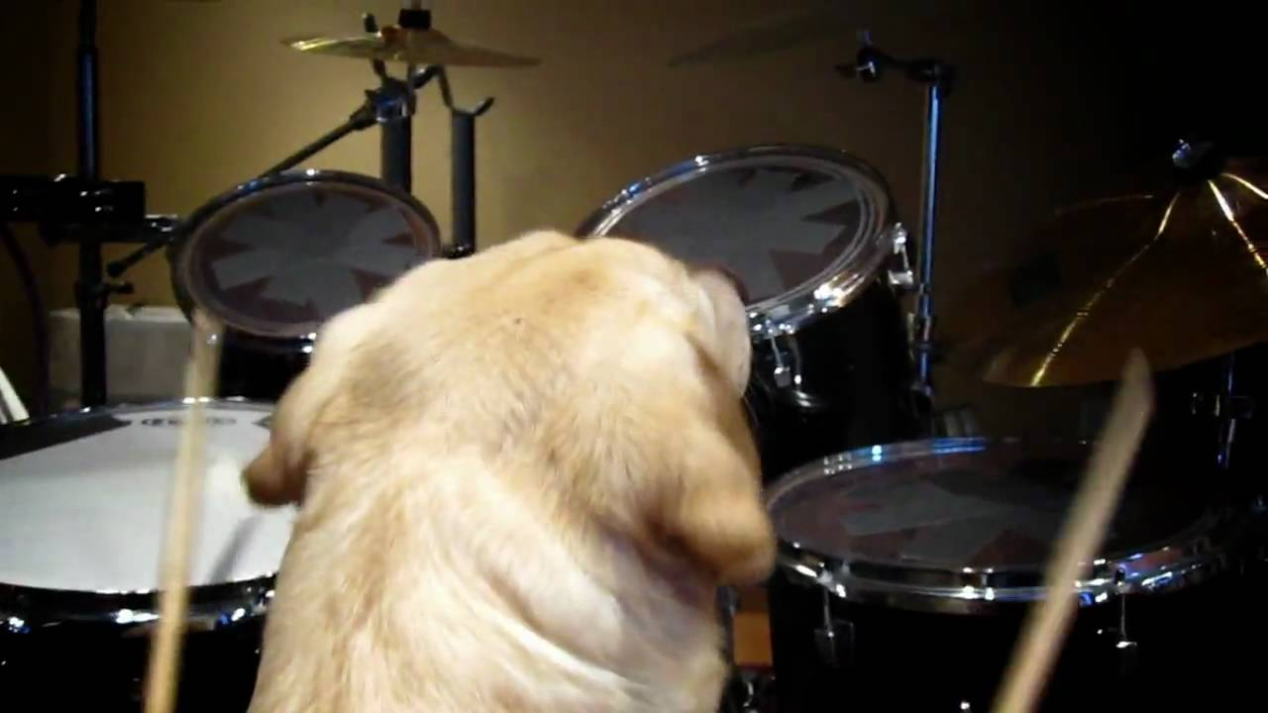
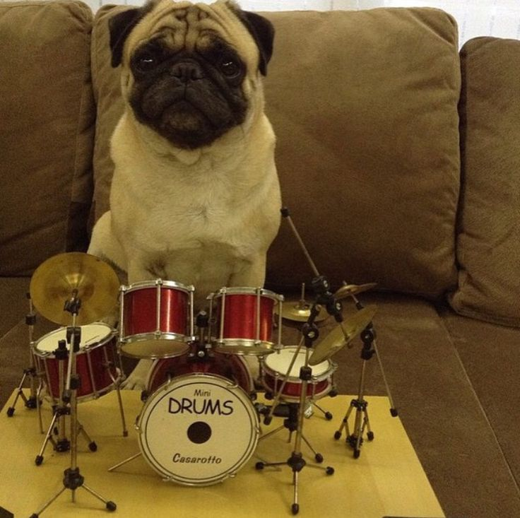
A.I. Duet with Percussion
Don’t worry, I already know that the current title is not clever or interesting. If you have suggestions share them pls
This project is based on Magenta, which is a program that allows one to play some piano via the keyboard and then computes a duet based off of that. https://aiexperiments.withgoogle.com/ai-duet/view/
Being that I am not a classically trained musician I decided to go a different route and create a Magenta-inspired program that features drums instead of a piano.
Using the Tone.js and NexusUI code that was graciously shared with me, I* encoded various rhythms for the program to use.
For the sake of simplicity, everything is based off of 16th notes at 120 tempo within a 4/4 time signature
There are two components: bass and snare. There are specified keys on the keyboard for each sound.
Overall goal: user plays a rhythm using the keyboard, and the program plays a different rhythm back
If the user plays mostly snare, the program will return a bass rhythm, and vice versa
*Tom showed me how to do basically everything and I more or less followed along

